Slide 1

Splay tree
Search tree – data structure
Group Members
Mehdi Raza Rajani (k163904) Leader
Tahir Raza Hemani (k163905)
Sabih Ahmed (k163896)

Slide 2
Motivation for Splay Tree
Problems with Binary Search Tree
Not a balance tree
Worst Case is O (n) (when data entered is already sorted)
A lot of time to access recent inserted / searched element
Solution: AVL Tree
A balance binary tree
Worst case is O (log n)
Multiple Rotation (Left, Right, Left Right and Right Left rotation)
Problems with AVL Tree
Extra storage for height field in each node.
Calculation of Balance Factor can be sometime difficult
Ugly deletion of AVL Tree (around 12 different cases)
A lot of time to access recent inserted / searched element.
Solution: SPLAY TREE
Deletion was made simple
Recently inserted / searched element always be on root of the tree

Slide 3
Application OF splay tree
Due to their reference of locality property, they can be used in implementing logic behind caches.
Also they can be used in bifurcating the data into 2 distinguish data sets – cutting a tree (left subtree and right subtree during deletion.)
Can be used in garbage collectors
Querying faster than O(log(N)) for highly biased query distributions
Used in network router

Slide 4
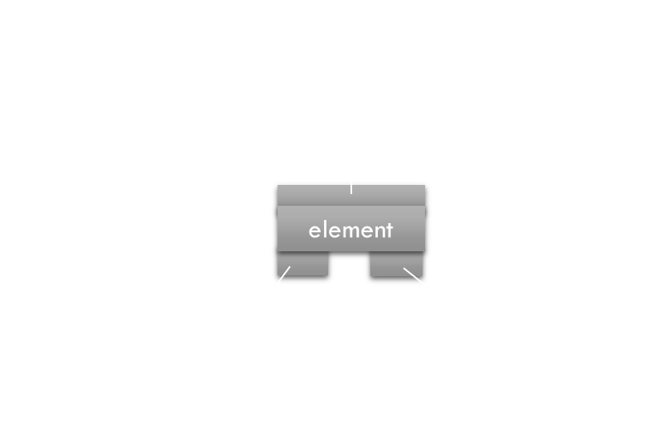
Splay Node
EACH SPLAY NODE CONSIST OF THE FOLLOWING THINGS:
SPLAYNODE PARENT
OBJECT ELEMENT
SPLAYNODE LEFT
SPLAYNODE RIGHT

Slide 5
Different types of rotation in splay tree

Slide 6
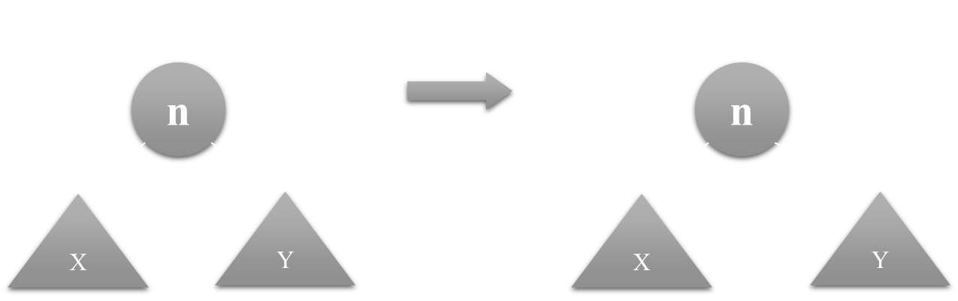
Access root
No change occurs

Slide 7
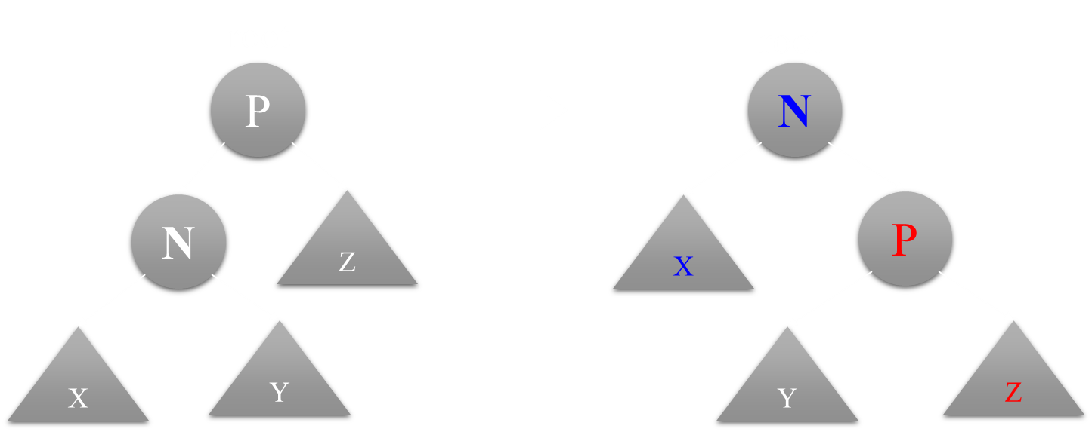
Zig Rotation
(Single AVL rotation) – Access child of root

Slide 8
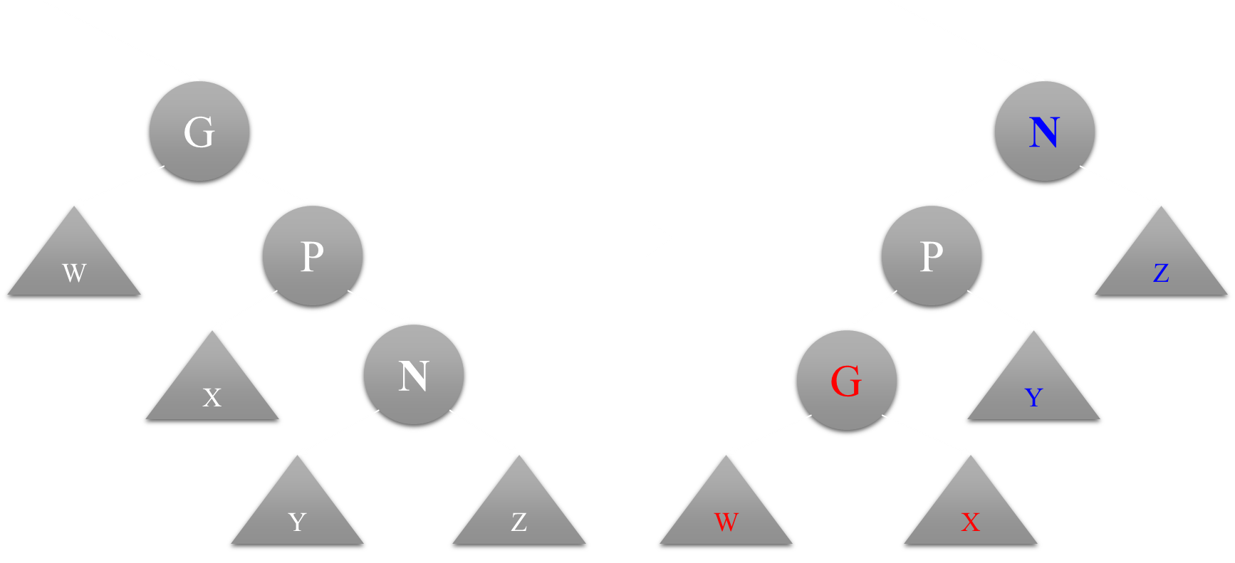
Zig zig rotation
ACCESS LEFT-LEFT OR RIGHT-RIGHT GRANDCHILD

Slide 9
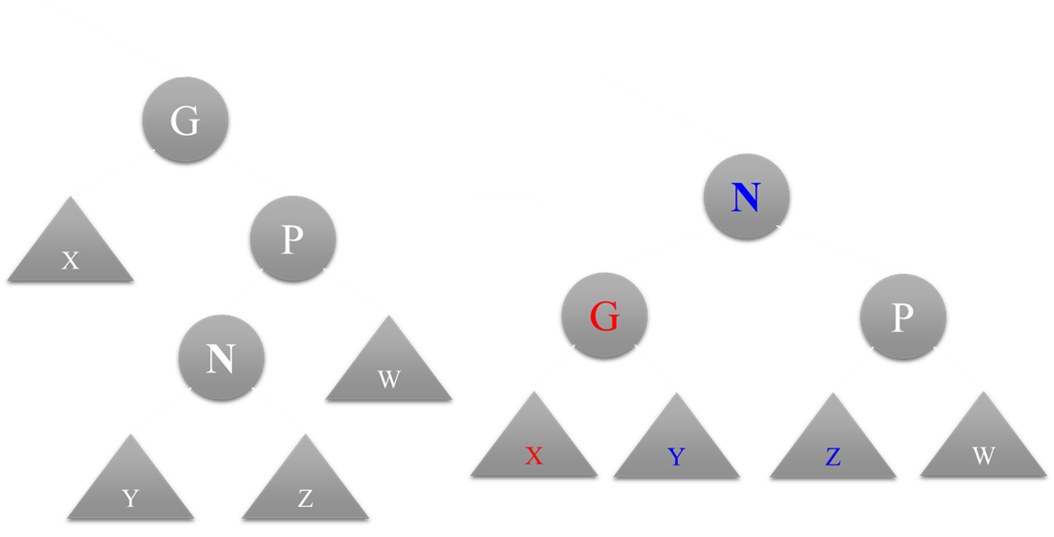
Zig zag rotation
ACCESS LEFT-Right OR RIGHT-LEFT GRANDCHILD – double rotation AVL

Slide 10
Basic operations in splay tree

Slide 11
Searching in splay tree
Node search(object x)
Temp ← root
If (temp = null) return null //empty tree
If (temp.key = x) return temp
While (temp != null)
If (temp.key.compareTo(x) < 0 ) temp ← temp.left
else if (temp.key.compareTo(x) > 0 ) temp ← temp.right
else return splay (temp) //when found splay it move it on to the root of tree
Return null //not found

Slide 12
Insertion in splay tree
Void insert(object x)
Temp ← root
Par ← null
While (temp != null)
par ← temp
If (temp.key.compareTo(x) < 0 ) temp ← temp.left
else temp ← temp.right
Temp ← new Node (x)
Temp.parent ← par
If (par = null) root ← temp
Else if (par.key.compareTo(x) < 0 ) par ← par.right
Else par ← par.left
Splay(temp) //after inserting splay it move it on to the root of tree

Slide 13
Deletion in splay tree
Node delete(object x)
If (root = null) return null //tree is empty
If (search(x) = null) return null //x is not present in tree
//now the object to be deleted is on root of the tree
Temp ← root
If (root.isLeaf())
root ← null
return temp
If (root.isEither())
If (root.left != null)
root.left.parent ← null
root ← root.left
Else
root.right.parent ← null
root ← root.right
return temp

Slide 14
Deletion in splay tree (continue)
//root is full node so now we will split the tree into left subtree and right subtree
leftTree ← root.left
rightTree ← root.right
Right.parent ← null
leftTree.parent ← null
T ← predecessor (leftTree)
Splay (T) //will move predecessor of root on the top
Root.right ← rightTree
rightTree.parent ← root
Return temp

Slide 15
Examples of splay tree

Slide 16
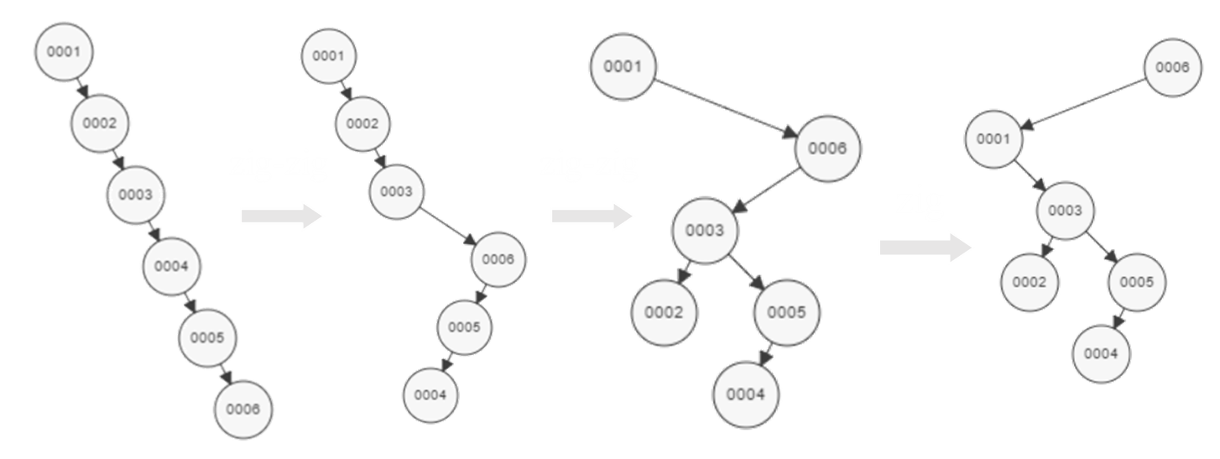
Search (6)

Slide 17
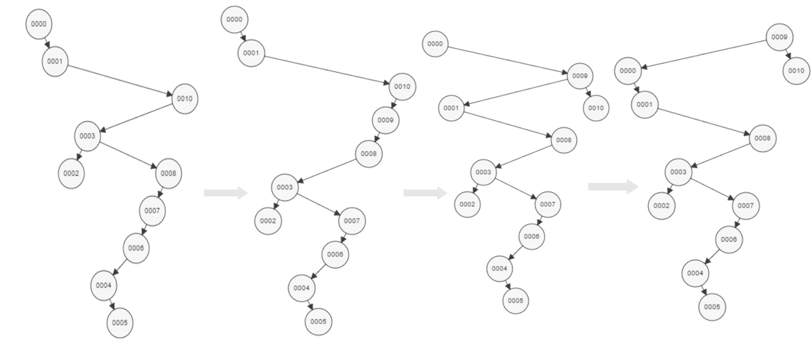
INSERT (9)

Slide 18
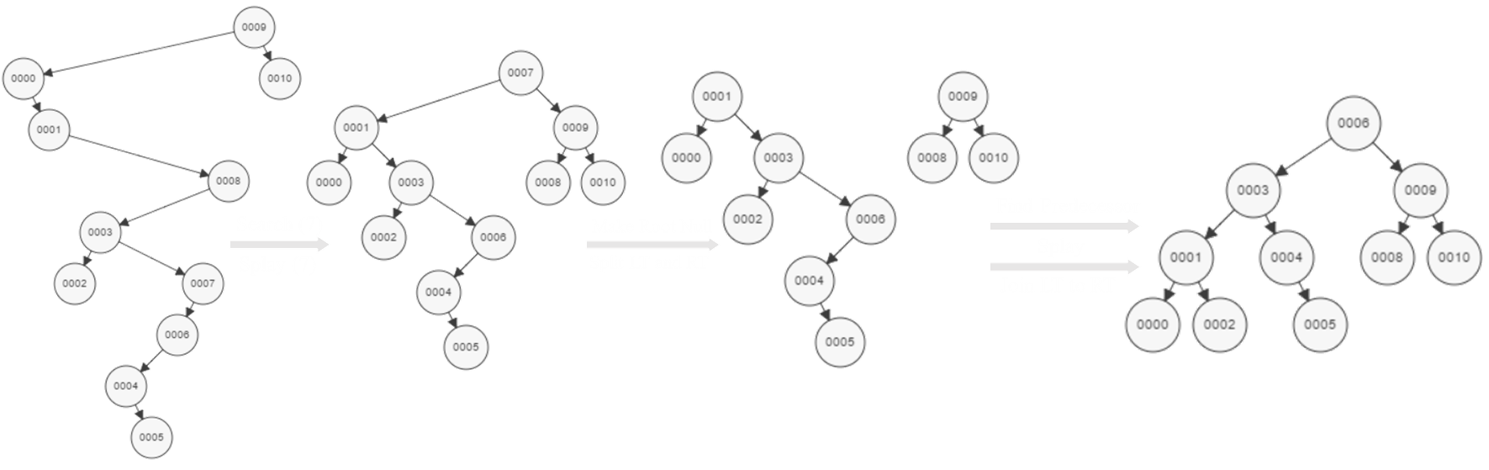
Delete (7)

Slide 19
Comparison and time complexity analysis

Slide 20
Splay Tree VS AVL Tree
Splay Tree | AVL Tree
In worst case only search, insertion and deletion may be O (n) if elements are inserted in order. Except this case each operation’s time complexity is O (log n). | Search, insertion and deletion can never be of O (n) time complexity. Time Complexity of AVL Tree is O (log n).
Operation on recent node is of O (1) time complexity always. | Operation on recent node can be of O (1) but often it is of O (log n).
Bad in multithread environment. | Good in multithread environment.
Perform merging and splitting efficiently. | Can’t perform merging and splitting.
More memory efficient because no need of Balance Factor in each node. | Less memory efficient because it require balance factor in each node.
Deletion is very simple. | Deletion is quite complex.
Better method to implement using iterative technique. | Better method to implement using recursive technique.

Slide 21
Insertion comparison graph

Slide 22
deletion comparison graph

Slide 23
accessing latest inserted node

Slide 24
Summary OF splay tree
Can be shown that any M consecutive operations starting from an empty tree take at most O(M log(N))
All splay tree operations run in amortized O(log n) time
Splay trees are tree structures that:
Are not perfectly balanced all the time
Data most recently accessed is near the root.
Implements most-recently used (MRU) logic
Splaying can be done top-down; better because:
only one pass
no recursion pointers necessary
Splay trees are very effective search trees
relatively simple: no extra fields required
excellent locality properties:
frequently accessed keys are cheap to find (near top of tree)
infrequently accessed keys stay out of the way (near bottom of tree)

